Slide 1
Milo Abolaffio
milo.abolaffio@gmail.com
PhD in complex systems (studied fat tails distributions, and its applications on movement ecology, analysis of GPS tracks)
Working at CloudForce in VarGroup as chief Data Scientist, using AWS and GCP to leverage AI solutions.

Slide 2
If dirty(data):
clean()

Slide 3
Preprocessing and
Cleaning Data
How to prepare data before ML models

Slide 4
Cleaning data
In general avoid to do it manually but use functions.
• This will allow you to reproduce these transformations easily and checks for errors.
• You will gradually build a library of transformation functions that you can reuse in future projects.
• You can use these functions in your live system to transform the new data before feeding it to your algorithms.
• This will make it possible for you to easily try various transformations and see which combination of transformations works best.

Slide 5
Typical Pipeline in Supervised Learning
Dirty/Raw Data
80%
Dirty Training Set
Exploration + Transformation Pipeline (P)
Model ML
20%
Dirty Test Set
Pipeline P
Performances

Slide 6
Preprocessing and Cleaning data
In Machine Learning it is typical to clean and preprocess data before building the model. This phase is usually long because a good preprocessing can improve the result of the model. In ML it is famous saying:
GARBAGE IN → GARBAGE OUT
If you give your model bad data, dirty data, the results is not good (GARBAGE).

Slide 7
What is a Pipeline?
In general, a pipeline is an ordered sequence of operations to apply to a dataset. Pipeline transforms the data from Dirty to Clean.
The Pipeline must be built on the characteristics of the training set (to clean training set) and applied to unseen data (data that the model never saw = Test set).

Slide 8
Common data problems
Untidy data
Missing data
Outliers
Duplicate rows
Inconsistent column names
Inconsistent categorical values
Inconsistent formatting or unit measure
Just leaved out the easy and boring stuff.

Slide 9
Type of data
There exists some type of data:
Numerical (continuous)
Nominal (not possible to sort them - like: animals)
Ordinal (it is possible to sort them - like: sizes of clothes)

Slide 10
Tidy dataset
Hadley Wickham defined "Tidy Data" as data sets that are arranged such that each variable is a column and each observation (or case) is a row.

Slide 11
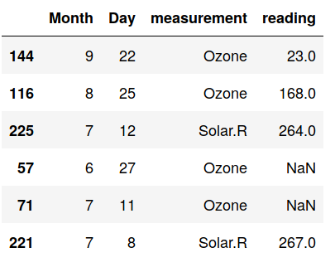
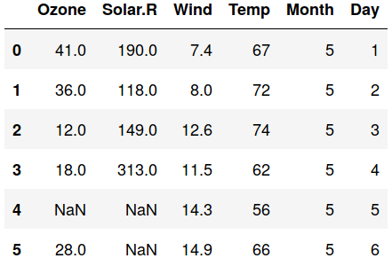
Tidy dataset
Even worst if there is no tracking of NaN!

Slide 12
Dealing with NAN
1. NaN
2. None
3.
4. “Null”
5. “missing”
6. “not available”
7. “NA”
8. This is the path to hell
If your dataset has some missing values, you need to fix them.
You have three options:
• Get rid of the corresponding rows.
• Get rid of the features containing NaN.
• Set the missing values to some value ( the mean, the median, etc.).

Slide 13
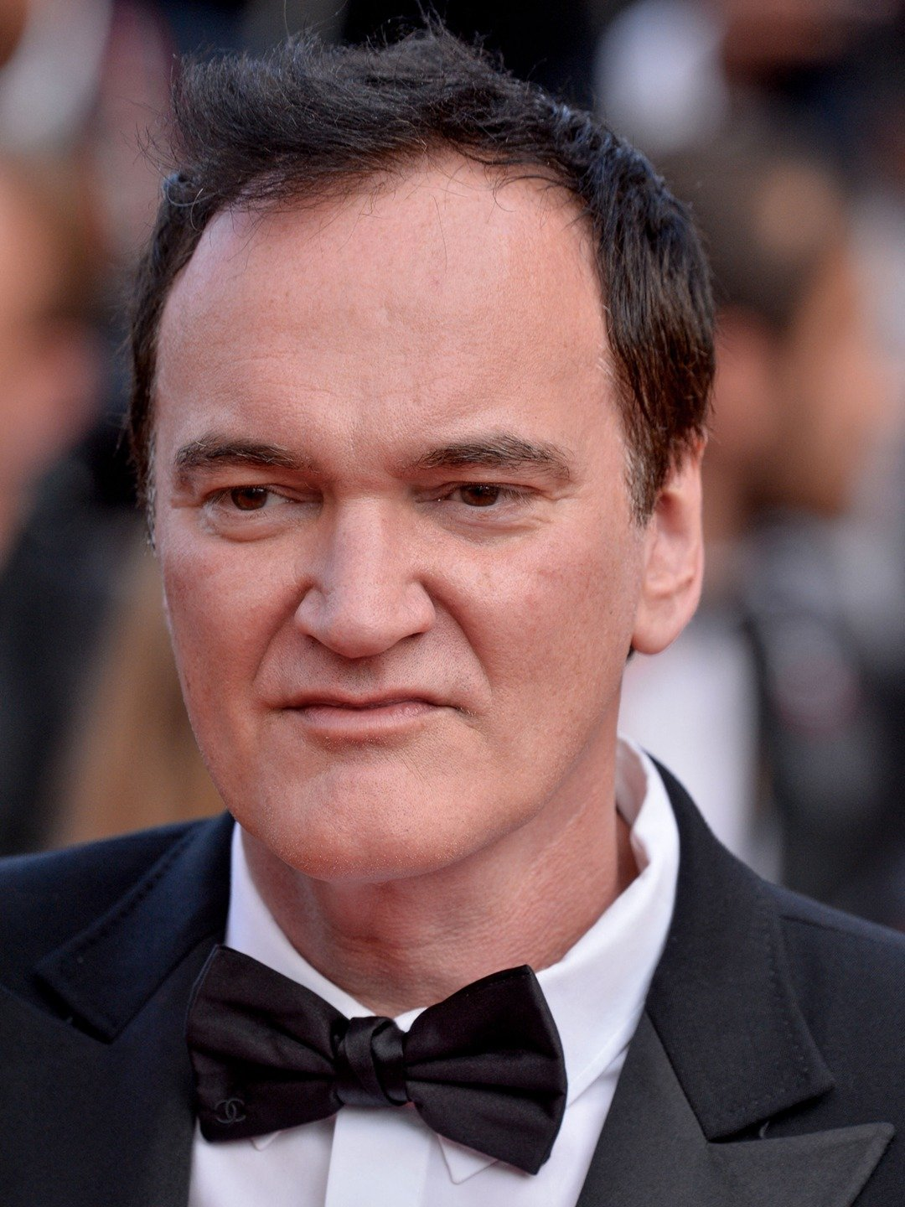

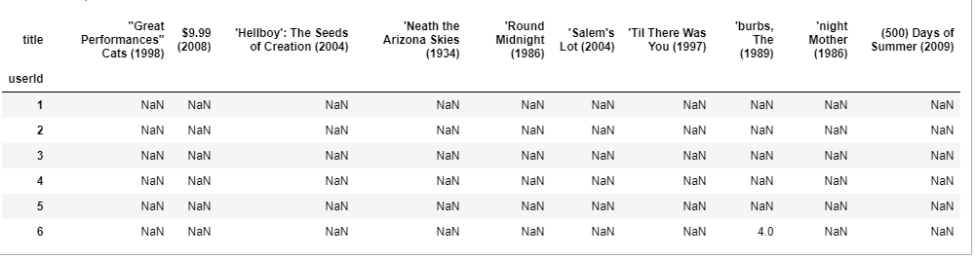
Disclaimer
Some dataset are by nature sparse (meaning full of mixing values). Like movies rating datasets: no-one except tarantino has seen all the movies. For these kind of dataset you should not perform any of the operations listed before!!! In fact there are other kinds of ML tools that can be applied for that dataset (like Matrix Factorization) that are specially design for this task..
Say NaN again!

Slide 14
Get rid of the observations/features
Using these you maintain only observations with full informations and you avoid to add spurius informations to your dataset.
In some tasks is common to drops all the rows containing a NaN.**(the sample of observations that have no missing data might not be representative of the all dataset)
You should get rid of a row if the percentage of NaN in the row is too big.
You should get rid of a row if it does not contain the target variable!*
You should get rid of a column if the percentage of NaN in the feature is too big.

Slide 15
Filling NaN
Deleting rows or columns imply deleting information!
In some case you will end up with a poor dataset and too less information!
For numerical features, 2 easy choice: the missing value can be filled with the mean or the median of the column.
Question which is the best for you? (Vote! and Carlo counts!)
Pros: Easy and fast. Works well with small numerical datasets.
Cons: Doesn’t take in account the correlations between features, works only at the column level. Not very accurate.

Slide 16

Problems with the mean
Outliers can heavily influence the mean value.
Example I have a grocery and one day Jeff Bezos enter to buy a liter of milk (a very realistic example XD ).
If then you compute the average of the salaries of your customers….. (Make it now: suppose 5000 customers with salary of 2000€ and JB with 6 Billions €) mean=(5000*2000+6*10^9)/5001 The median instead is very robust against outliers.

Slide 17
Easy choices for categorical features
For categorical features (some people use it also for numerical ones) you have two easy choices: -replace using the most frequent category - replace using a new invented category (e.g. ‘MISSING’).
Pros: Easy and fast.
Cons: Doesn’t take in account the correlations between features, works only at the column level. Most frequent, can introduce Bias in the dataset, while the new category can be too less informative for the successive ML algorithms.
Note: Usually in the pipeline process, we insert the one-hot encoding (or other kinds of encoding) for categorical features.

Slide 18
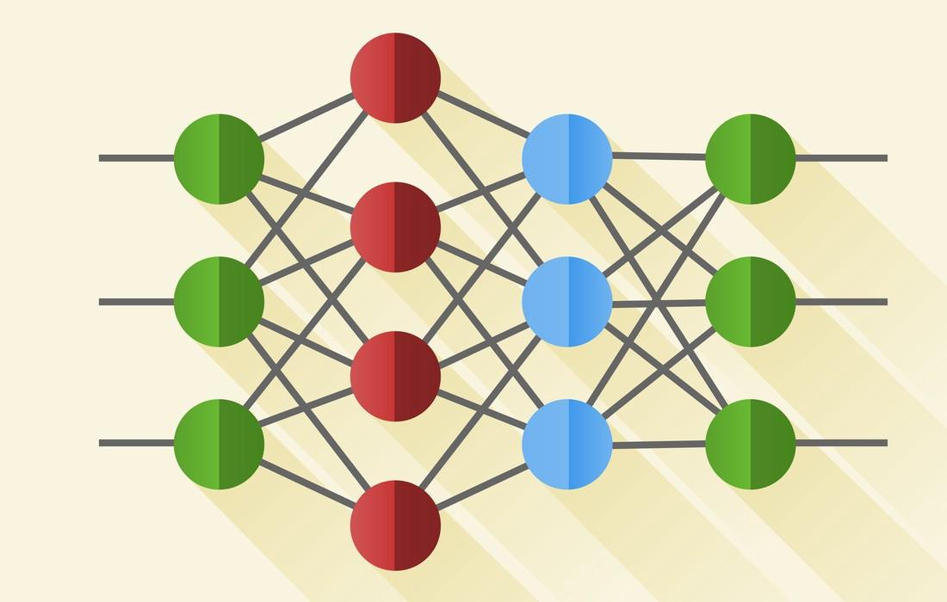
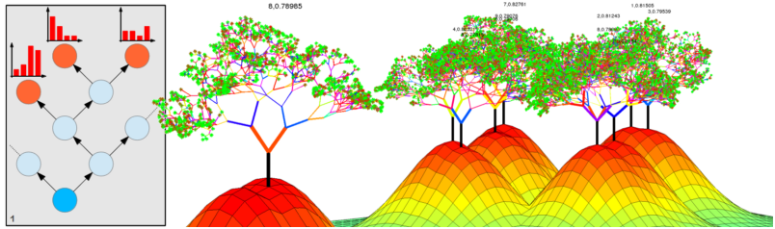
Use ML.
Use some of the ML algorithms that you will learn lately* in the course or others.
Like K-NN, Deep Learning, Naive Bayes.
Pros: Can be very accurate and boost your results.
Cons: You have a lot more work to do.

Slide 19
Which approach you should use?
Depends on your needs, and the task.
Be agile, start with the simplest one.
They will be your baseline so you can compare more complicated models
If the baseline and the complicated has the same results, stick with the baseline!
Some people use the train-validation-test scheme for the overall data cleaning + ML pipeline.

Slide 20

More on Missing data
What we said is just the surface of how to handle data missing.
When there are data missing we should always ask: why the data are missing?
There is any pattern in that?
There are plenty of example of bias in missing data, like in polling, where people that vote for questionable politicians tends to not answer.
“Choice of method for dealing with missing data is crucial for validity of conclusions, and should be based on careful consideration of the reasons for the missing data, missing data patterns and the availability of auxiliary information.”

Slide 21
Filling NaN (hardcore stuff, almost research)
Some algorithms give you the choice of weight more some observation and less other.
You can exploit this choice giving more importance to the observations with full information and less to the one where you filled the missing values.
Alternatively you can duplicate in the dataset the observations with full information.
Take care that this do not interfere with other parts in the data cleaning pipeline.
If missing values are not random, you increase the BIAS, so use it with extreme precaution. (I actually discourage you to do it)

Slide 22
More on Missing data II
Some algorithms (like the new randomforestSRC) handle also Missing values.
If you plan to use them (not always easy, these algorithms can be slow) the best solution is leave them as they are!!!
Disclaimer 2: Take special care with time series. In these datasets time is very important and you should not use the easy methods. Like using the average temperature in all the dataset resulting in a 10° in January in Berlin! (CRAZY!) For these datasets something else like the average of the nearests observation in time.

Slide 23
Lets go to the code! (where will do just easy stuff)

